Slide 1
Ottawa
Airbnb
Market Analysis
Group : Maple Leaves
Group Members:
Mariam Azam
Mohamed Alkooheji
Zainab Aloraibi

Slide 2
Contents
01.
Introduction
02.
Problem Statement
Ottawa and Airbnb overview.
The problem and goals.
03.
Analysis
04. Recommendations
Discuss results based on analysis.
Data-driven insights for the client.

Slide 3

Introduction
Ottawa is Canada’s capital, known for its government, history, and bilingual culture. It’s one of the most livable cities in the country.
Airbnb is an online platform that allows people to rent out their homes or rooms to short-term guests.
Ottawa
Notes:
Suggestion: Mention Ottawa’s population and total number of listings in Ottawa. Are the listings fewer compared to the pop. Or more?

Slide 4
Problem Statement
A client is considering investing in an Airbnb hotel in their city Ottawa, Canada. Before making a decision, the client wants to understand the current Airbnb market performance in the city.
Our goal is to conclude data-driven insights to give suitable recommendations to the client for their investment plan.

Slide 5
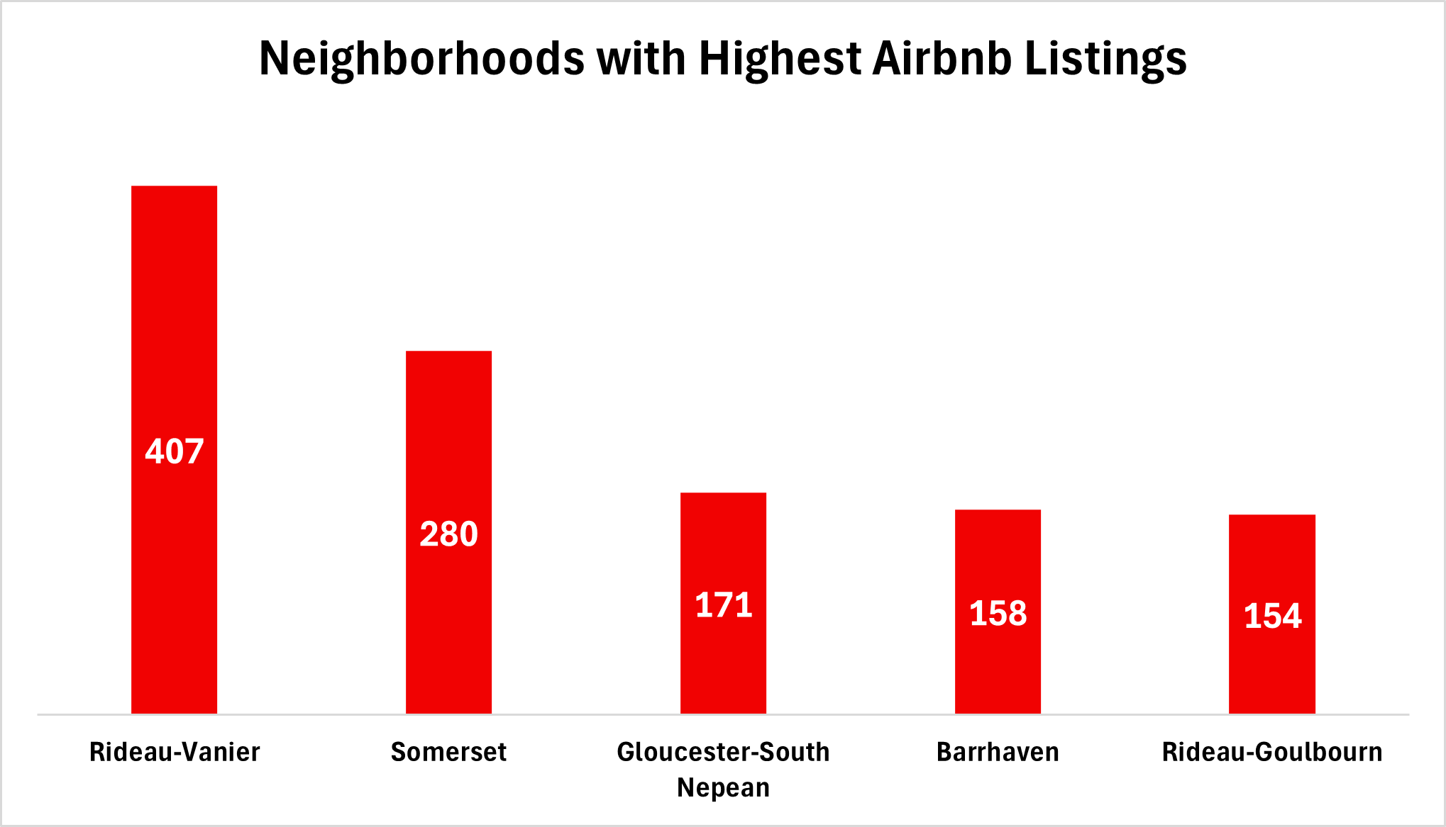
Neighborhoods With the Highest Number of Listings
Rideau-Vanier leads with the highest number of listings.
Notes:
Count of Airbnb Listings in All Neighborhoods

Slide 6
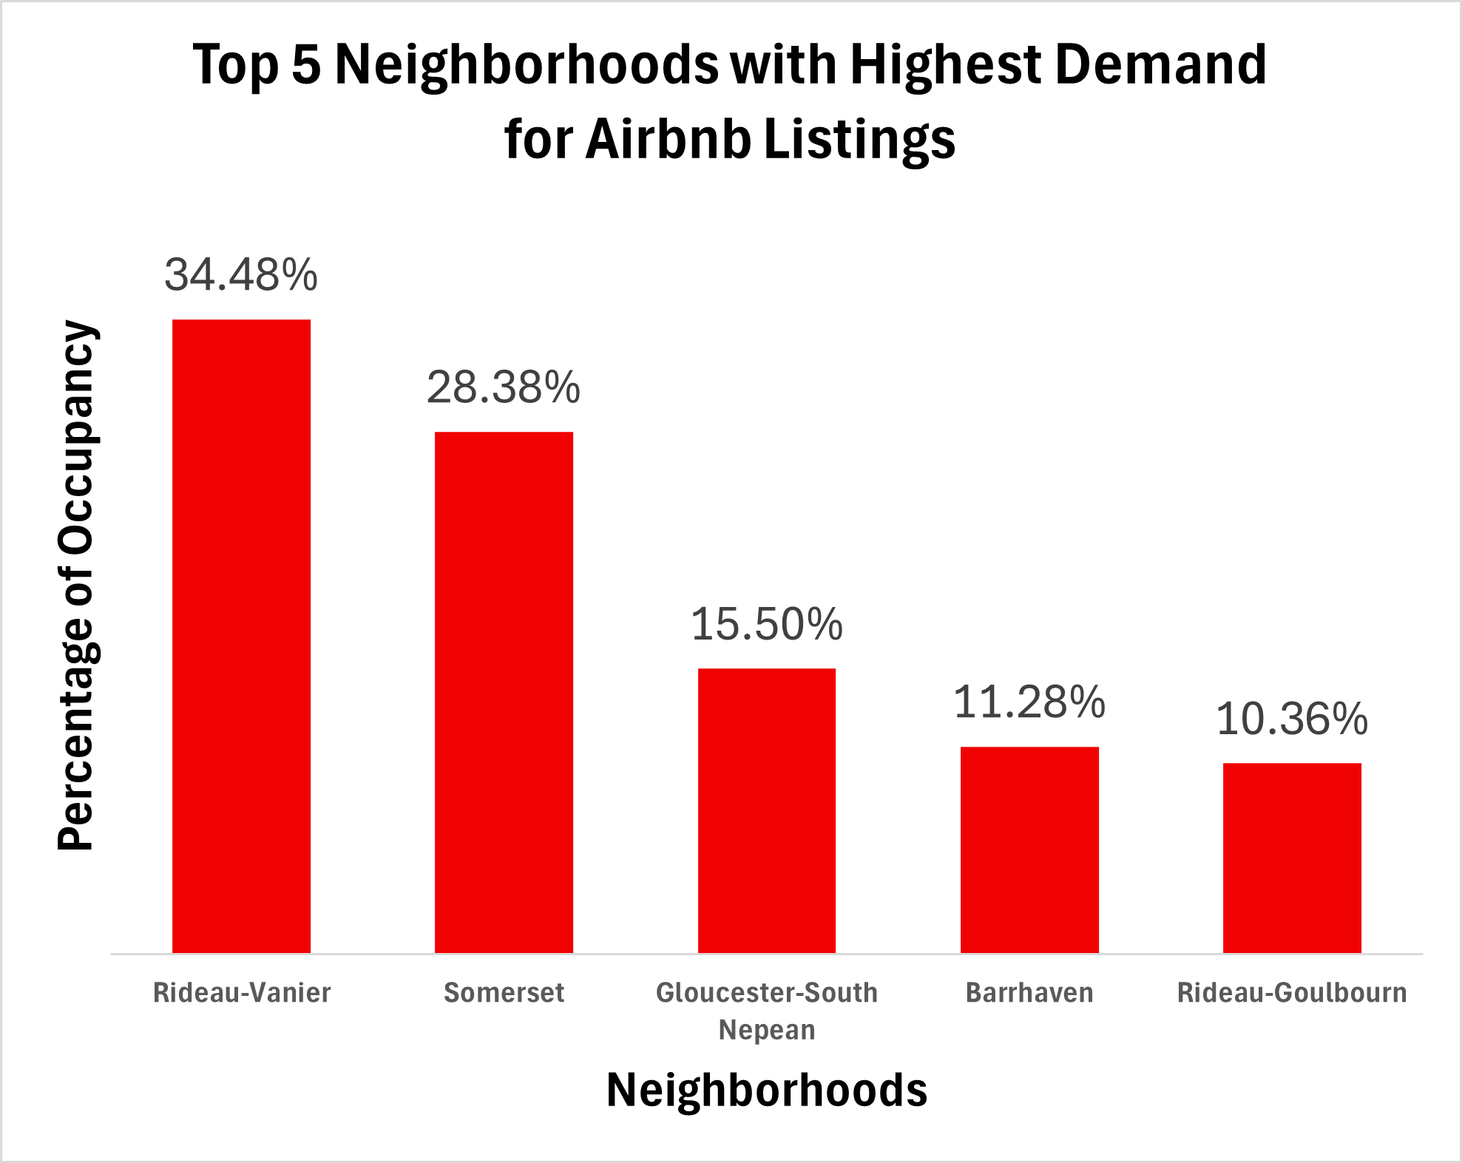
Listings with the Highest Demand
Rideau-Vanier leads with the highest occupancy percentage.
Notes:
Our definition of demand is how occupied a neighborhood is throughout the year. The chart shows Occupancy rate of one neighborhood compared to the others. Another way of analysing is to determine the occupancy rate of a neighborhood in a year. A new column: Occupancy/365x100 and then make a pivot table using this column.

Slide 7
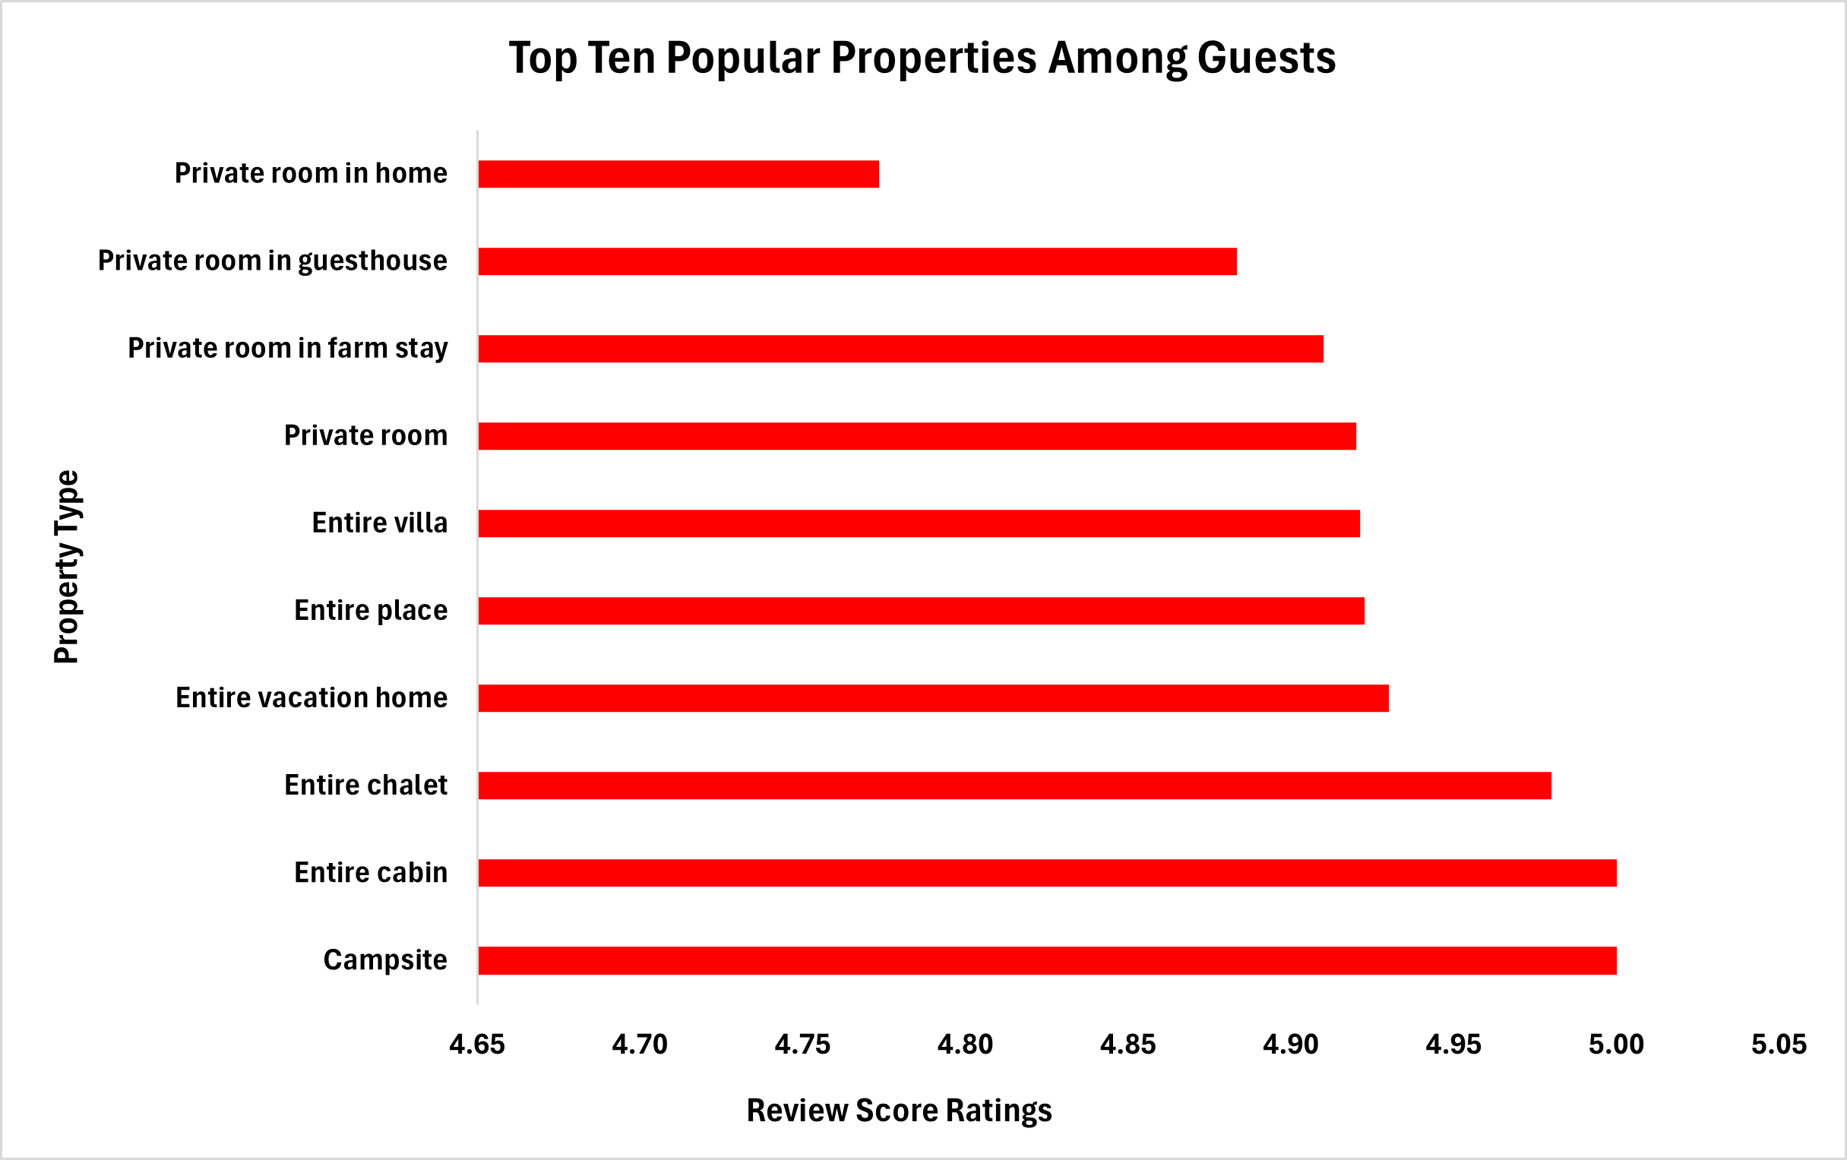
Popular Properties Among Guests
Campsites, entire cabins, and chalets are the top-rated properties based on guest reviews.
Notes:
Popularity of property types among customers based on Average of review score rating.

Slide 8
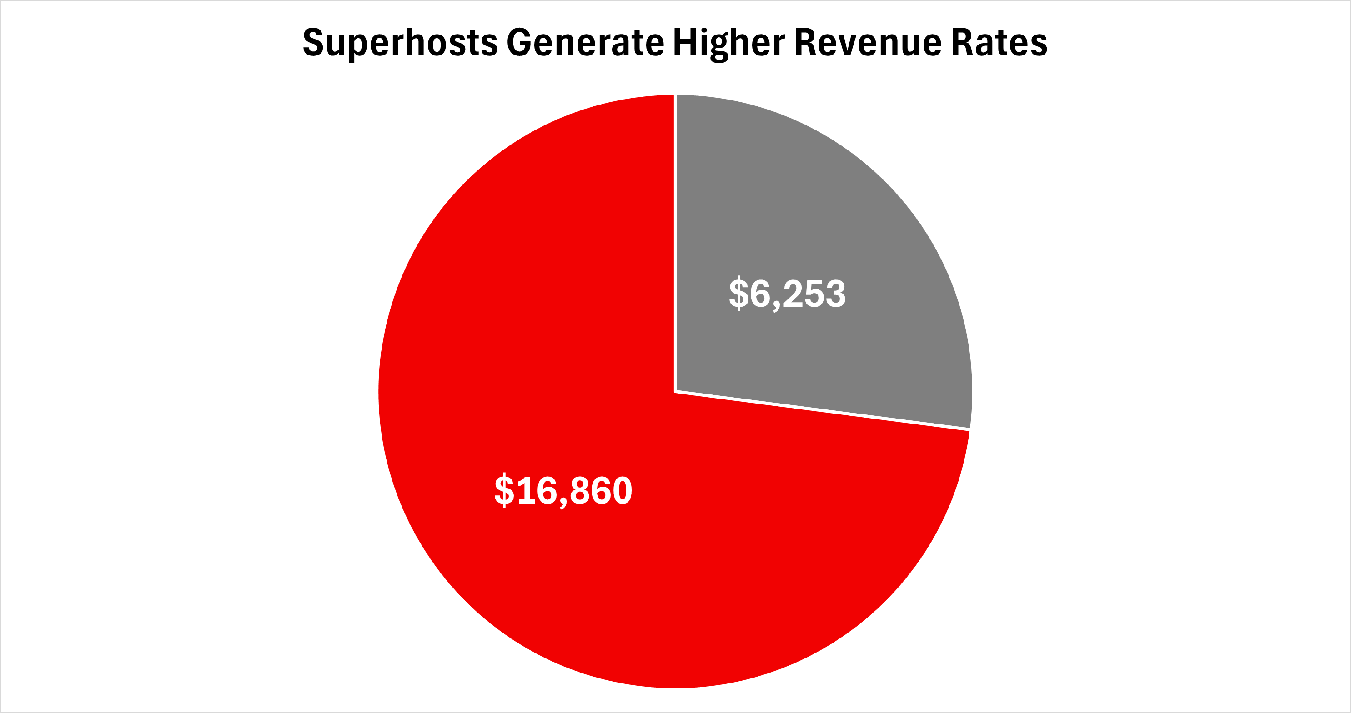
Earnings by Host Type
Superhosts drive higher revenue.
Regular Host
Superhosts
Notes:
Estimated revenue generated by superhosts vs regular host.

Slide 9
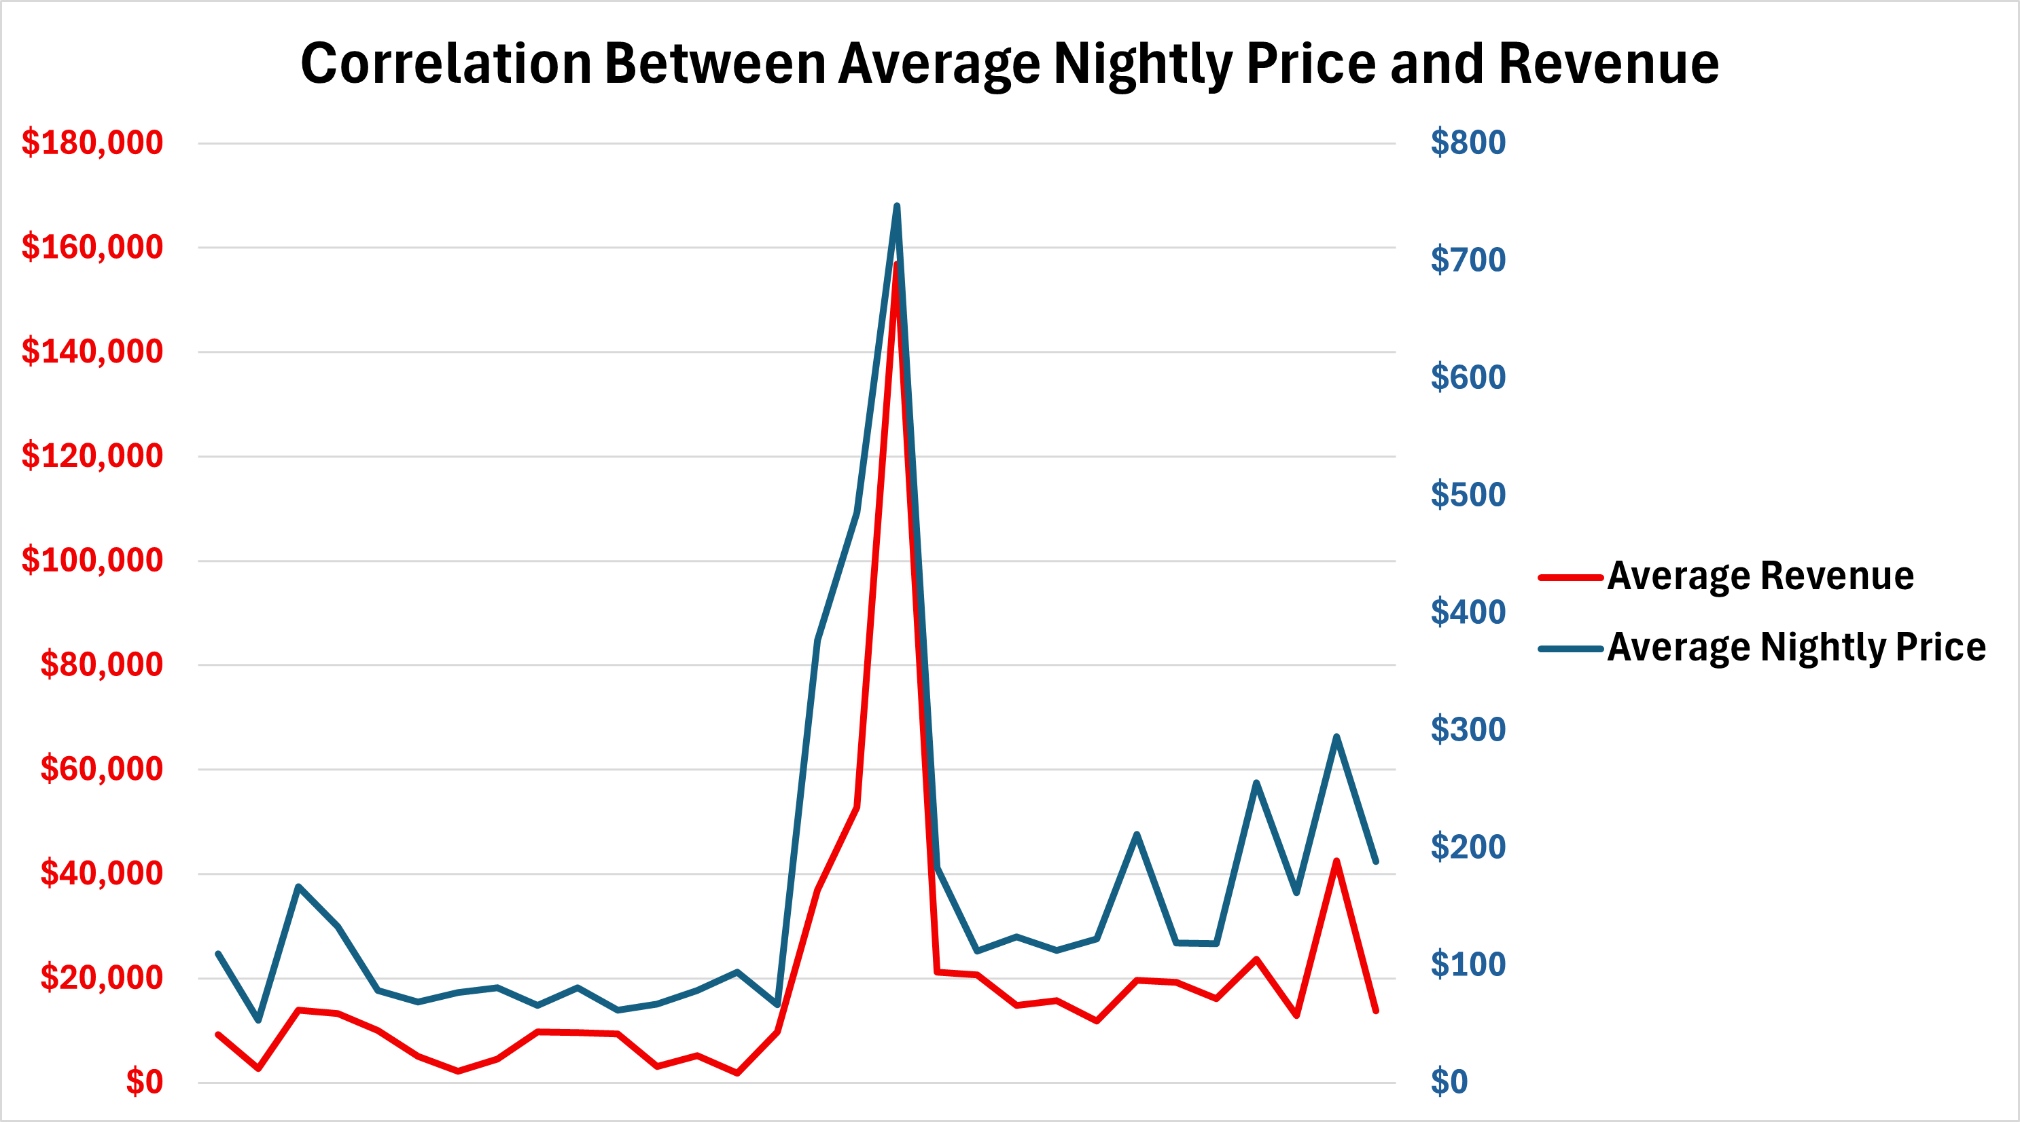
Average Price and Revenue
Revenue increases linearly with average price.
Notes:
Y-Axis has average prices of property types on left-side and the corresponding average revenue on the right-side. X-Axis shows the property-types.

Slide 10
Recommendations
Demand
Pricing
Consider investing in Rideau-Vanier. The area shows the highest demand, making it a prime opportunity for strong returns.
Focus on listings with higher average nightly rates they tend to generate greater overall revenue.
Customer
Preferences
Revenue Potential
Target Superhost listings they generate significantly higher revenue than regular listings, maximizing your earning potential.
Invest in cabins, chalets, and campsites- top rated by guests.

Slide 11
Thank You

